Slide 1
IMAGE ANALYSIS OF YEAST CELLS
Automatic yeast detection
Characterization of the growth phase
Identification of physiological features

Slide 2
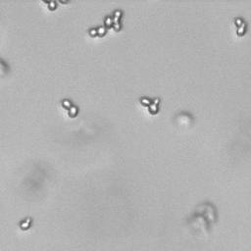
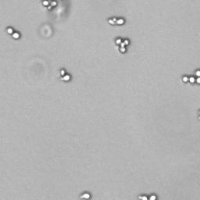
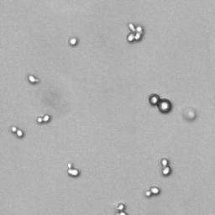
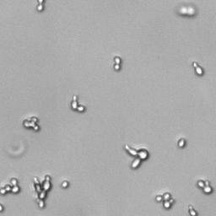
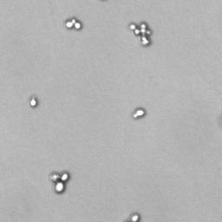
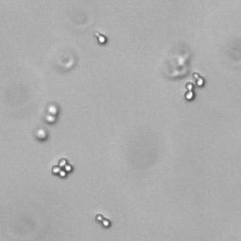

Slide 3
Classification
Yeast classified in
Single cells
Buddying cells
Clusters
Elongated cells
Contaminants

Slide 4
Detection and Classification

Slide 5
Growth phase characterization

